Slide 1
Automated Aquaponic Greenhouse
1
BY: JAHANZEB CHANNA, HAISU(JACK) ZHAO, HUNTER MCCAULEY, ARYAN SHARMA

Slide 2
Introduction
2
The goal of this project is to create an automated greenhouse that uses aquaponics as a way for providing nutrients to the plants
The system will be a set and forget build that should run fully autonomously
It will house two different planting methods, the flood & drain system and the drip irrigation method
Target group

Slide 3
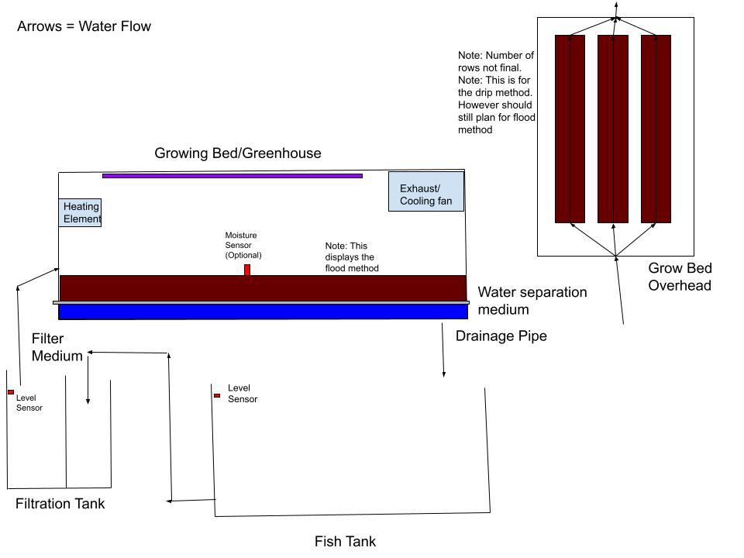
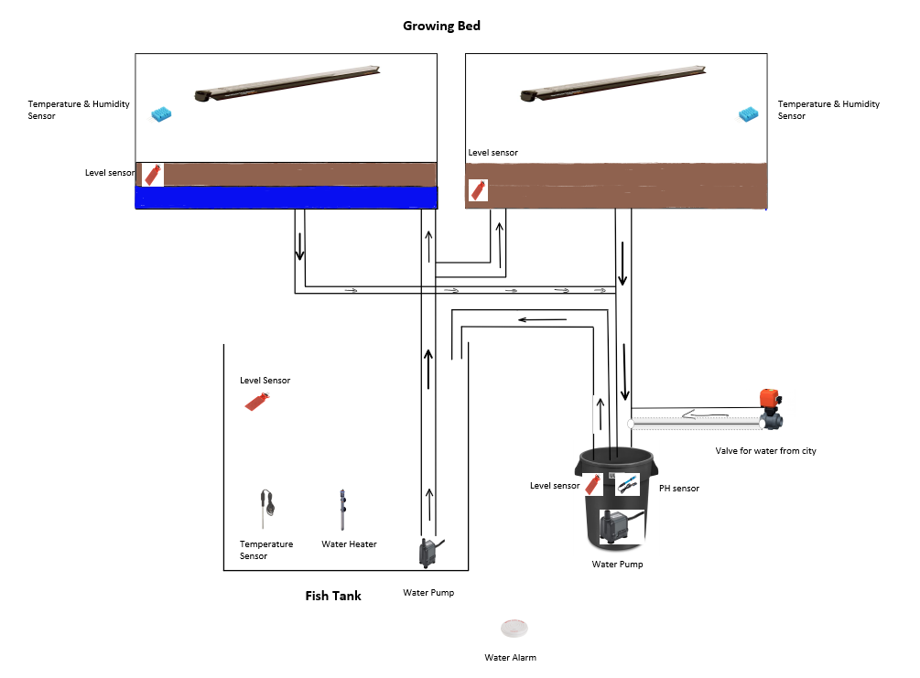
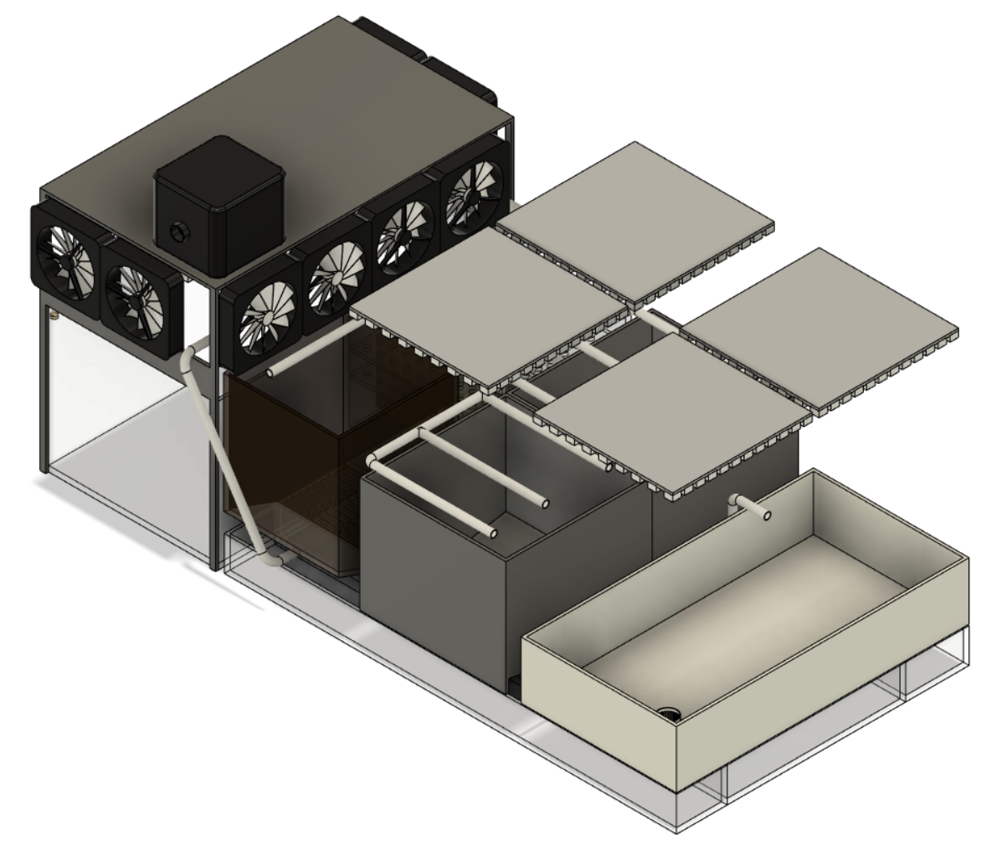
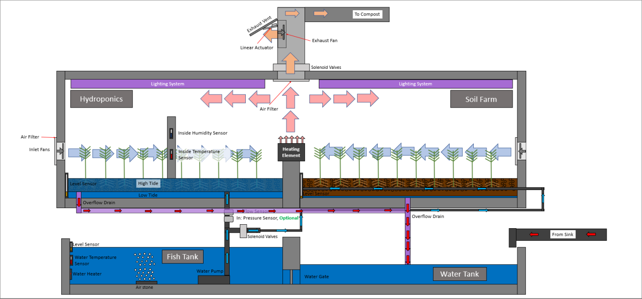
Initial Designs

Slide 4

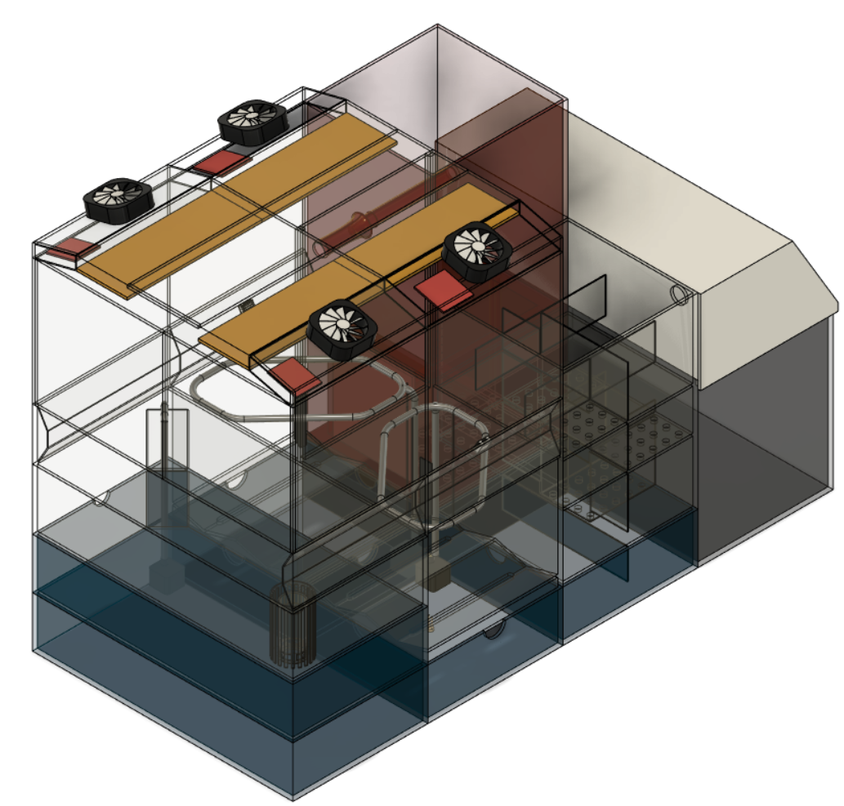




3D Model

Slide 5
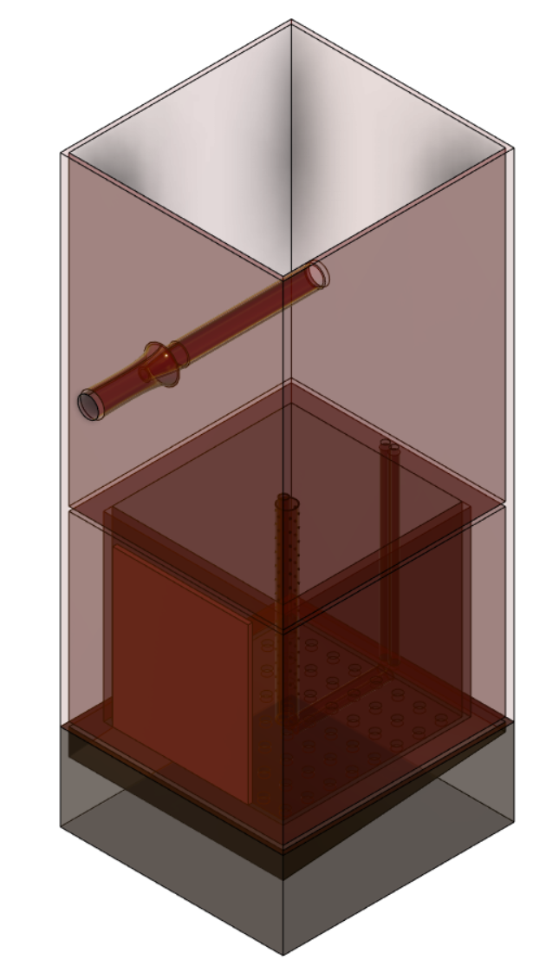
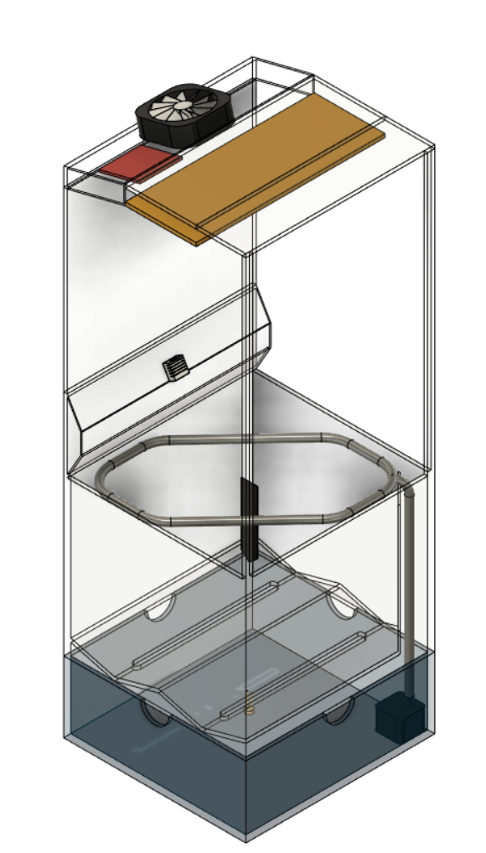
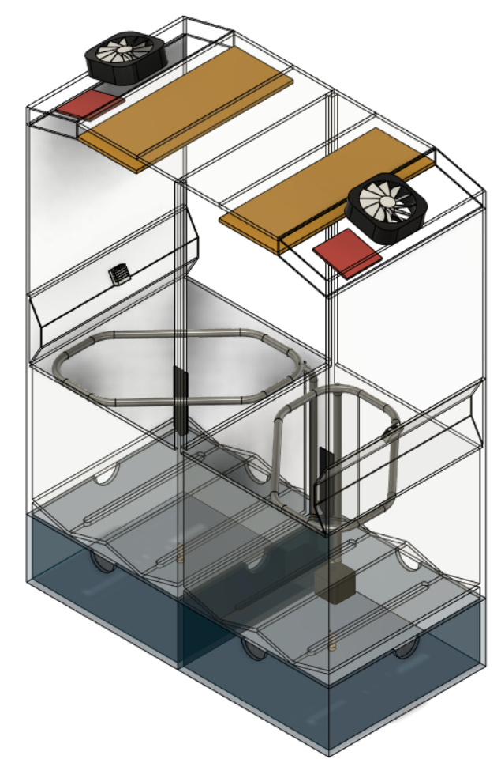
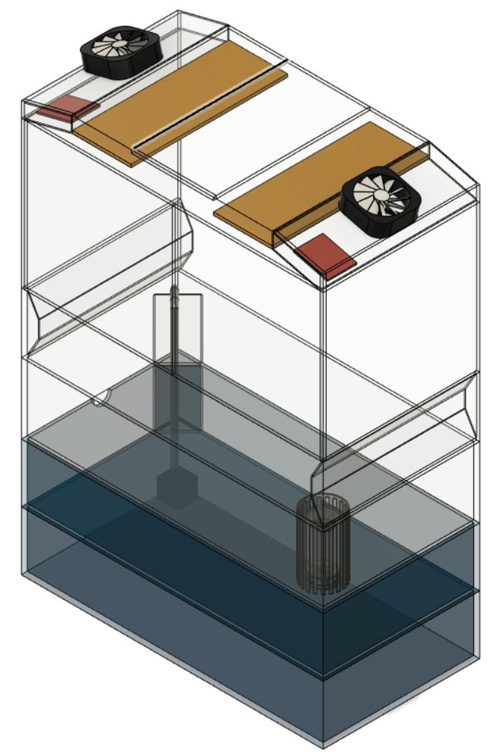
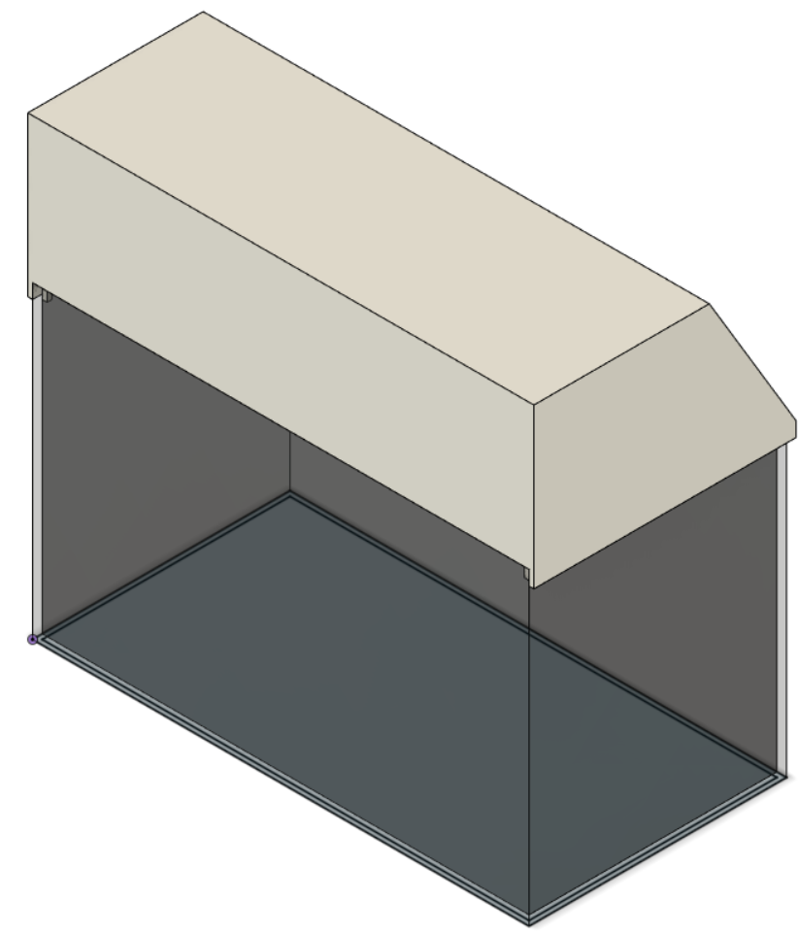
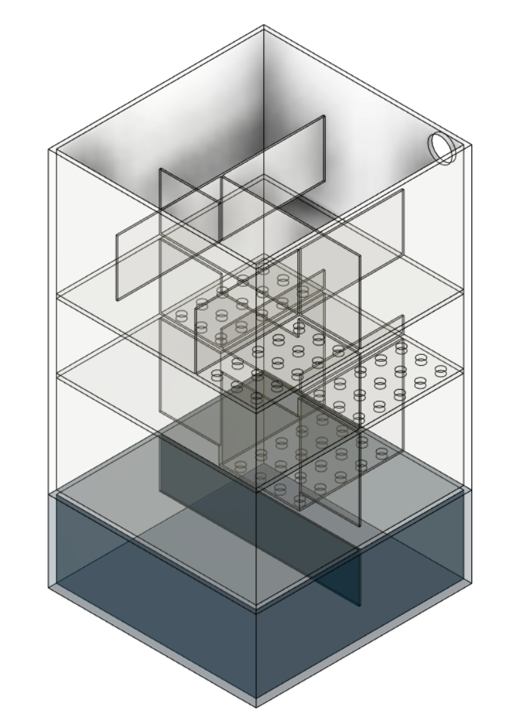
Composting Unit
Soil Irrigation Units
Hydroponic Unit
Fish Tank 10-Gallon
Bio Filter Unit

Slide 6
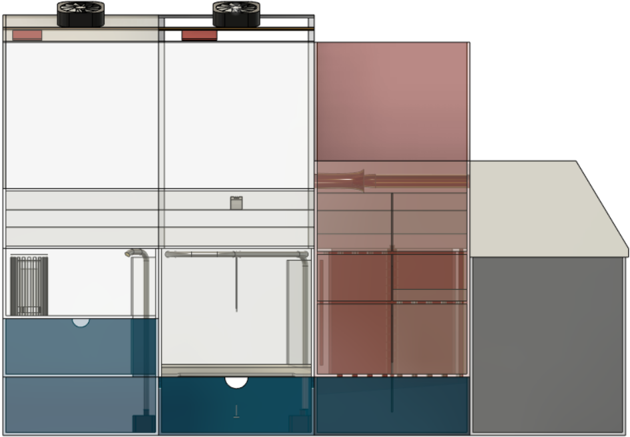
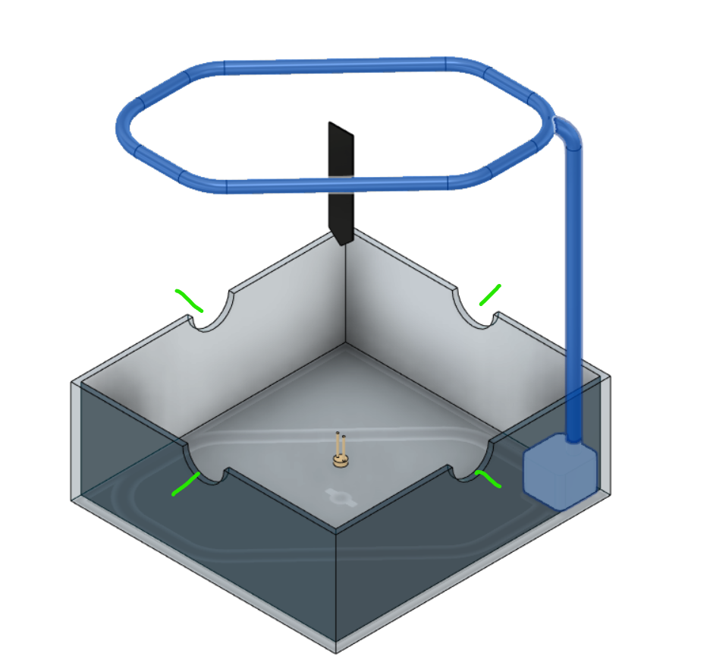
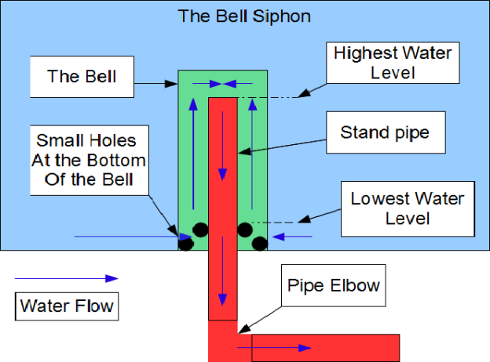
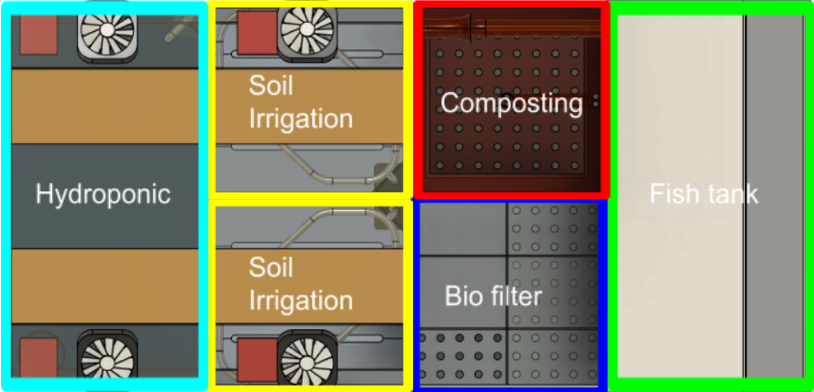

Slide 7
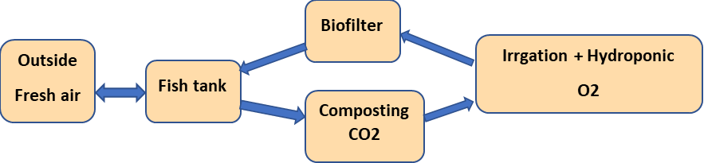
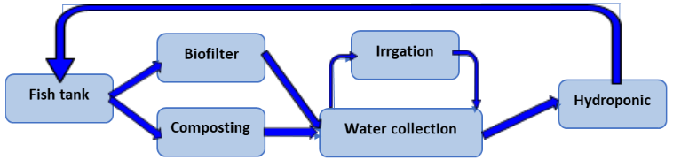
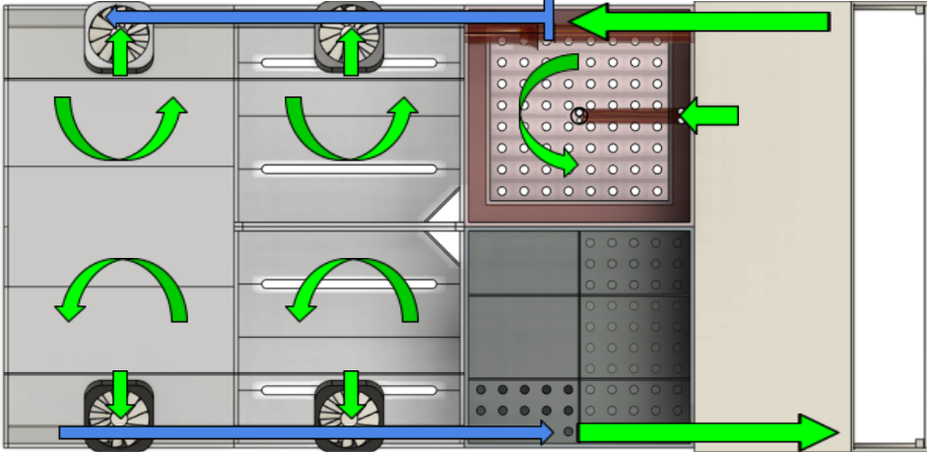
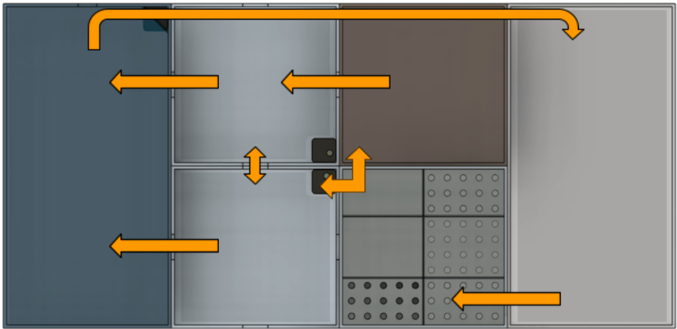
Air flow Water flow

Slide 8
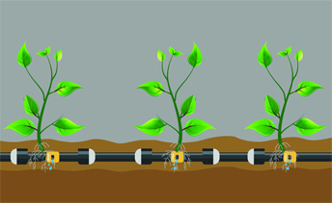
Drip Irrigation System
Uses the drip irrigation method
It features a tube or pipe that runs along the surface or close to the surface of a grow bed and slowly drips water
The water does not need to be constantly flowing at the soil will absorb and store a decent amount of water
Allows for a decent amount of plants to be grown
Advantages | Disadvantages
Very large variety of plants | Solids need to be removed from the water stream to avoid blockages in the pipes/tubes
Can grow very large plants | Difficult to relocate the system
Beginner Friendly | Very heavy
Highly used in commercial settings | Requires a certain amount of energy to keep the pressure in the pipe/tube to ensure even distribution
Plenty of room for plants roots to grow | Potential for tears or blockages in pipes/tubes that require replacement
Allows for nutrients through soil

Slide 9
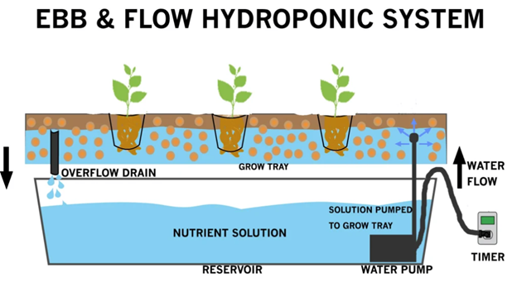
Flood & Drain system
The Flood and Drain System is a very commonly used hydroponic system.
It features a large grow bed that is periodically flooded for a few minutes to provide nutrients to the crops.
Crops can stabilize themselves by place their roots into a growing medium just as they would in soil
Advantages | Disadvantages
Very large variety of plant | Not good for Deep rooted plants
Can grow very large plants | Very difficult to move
Beginner Friendly | Very heavy
NO Separate solid and biological filtration system needed | Expensive to build
Growing beds acts as a solid and biological filtration system | Labour intensive
Constant Mineralized solid through bacteria breakdown | High labor costs
 | Not the best for commercial purposes

Slide 10
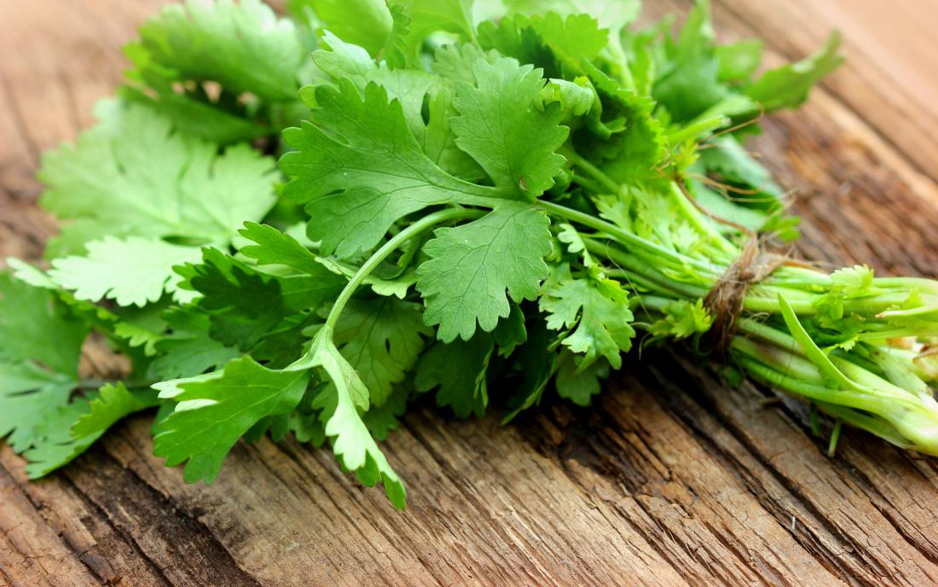
Type of Plants in the system
Radishes: Maturity 25 days
Spinach: Maturity 30 days
Dill: Maturity 40 Days

Slide 11
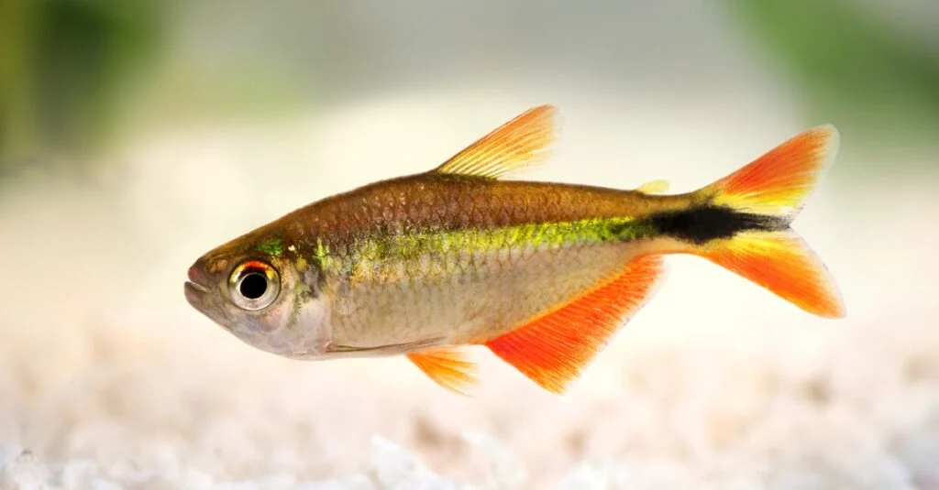

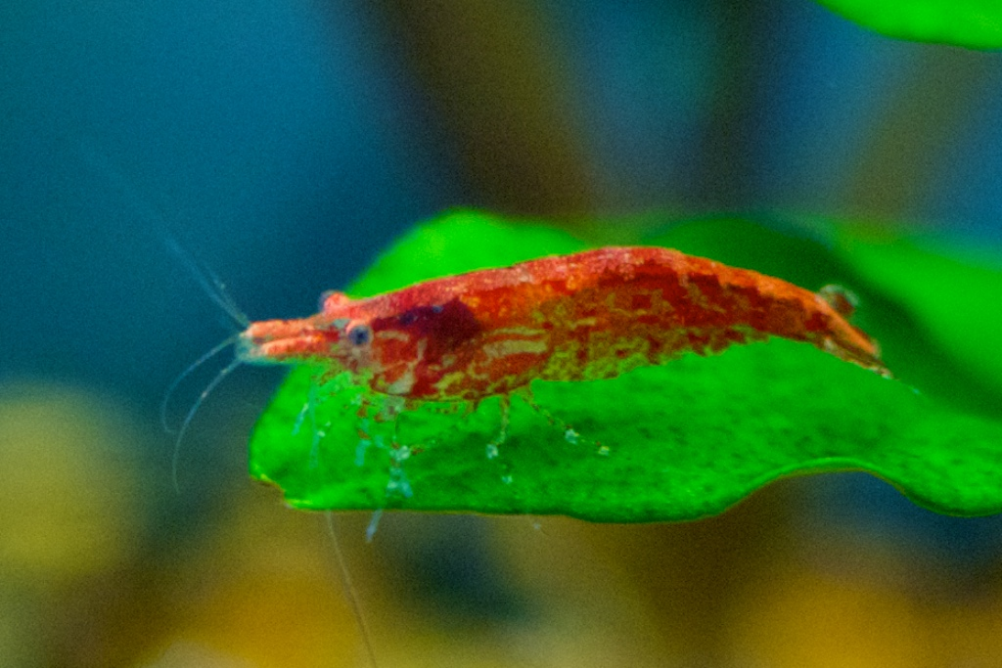
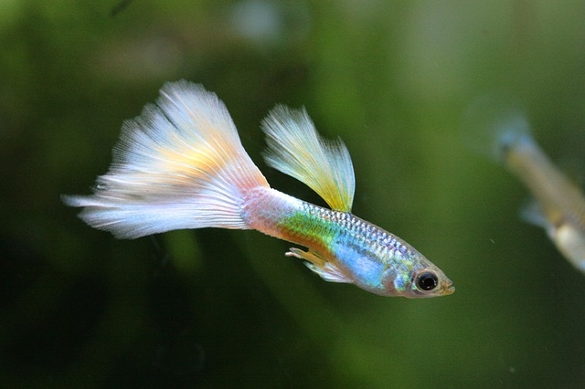
Fishes in the Aquaponic system

Slide 12
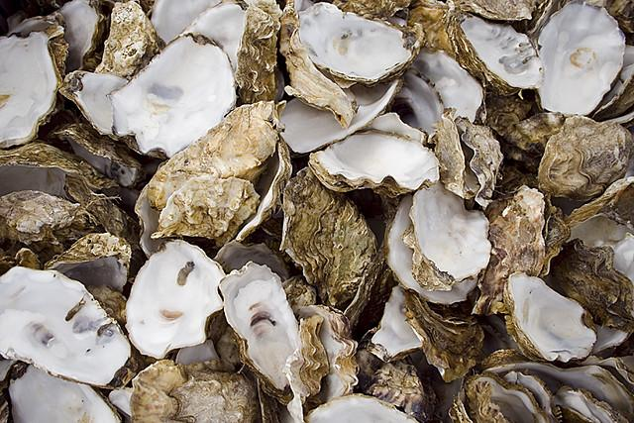
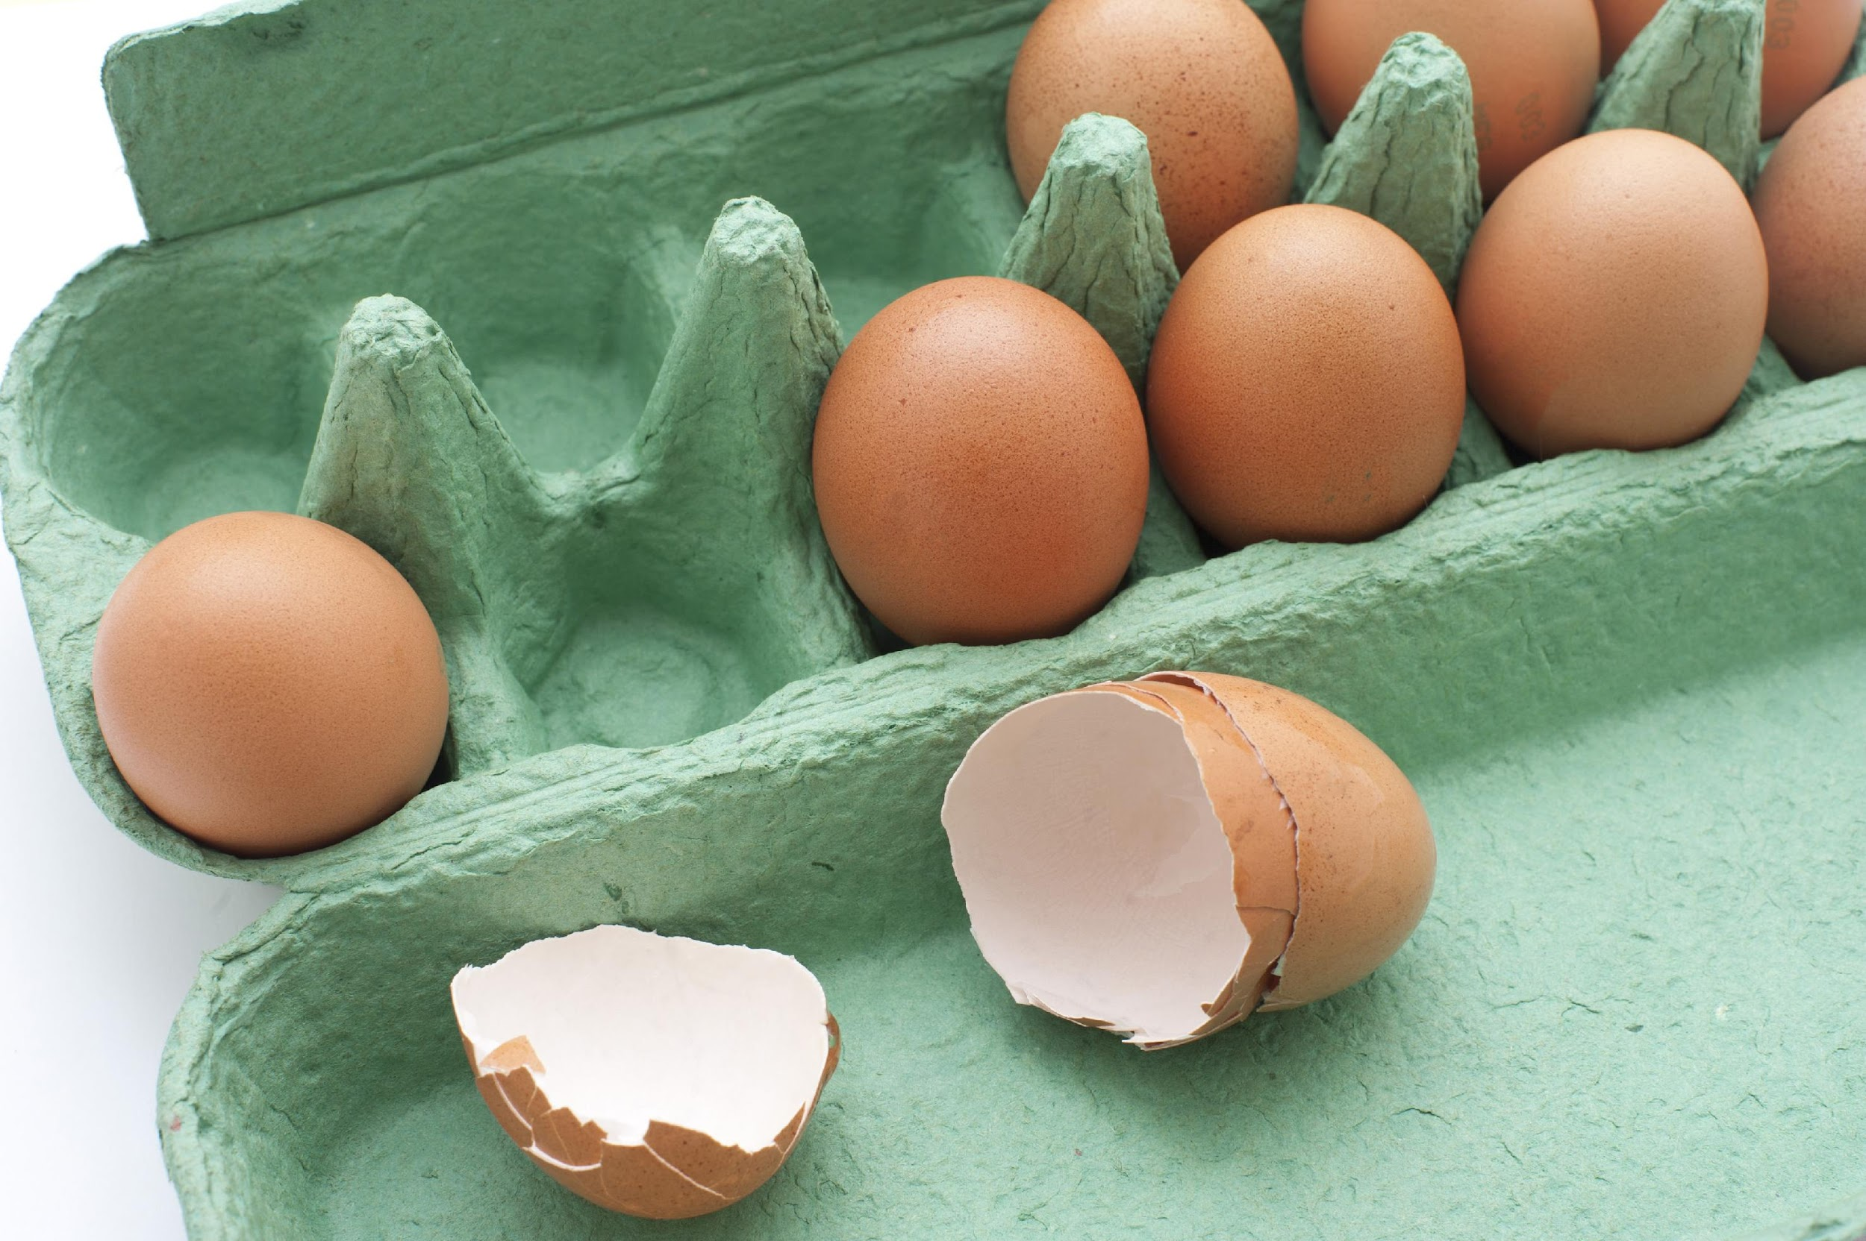
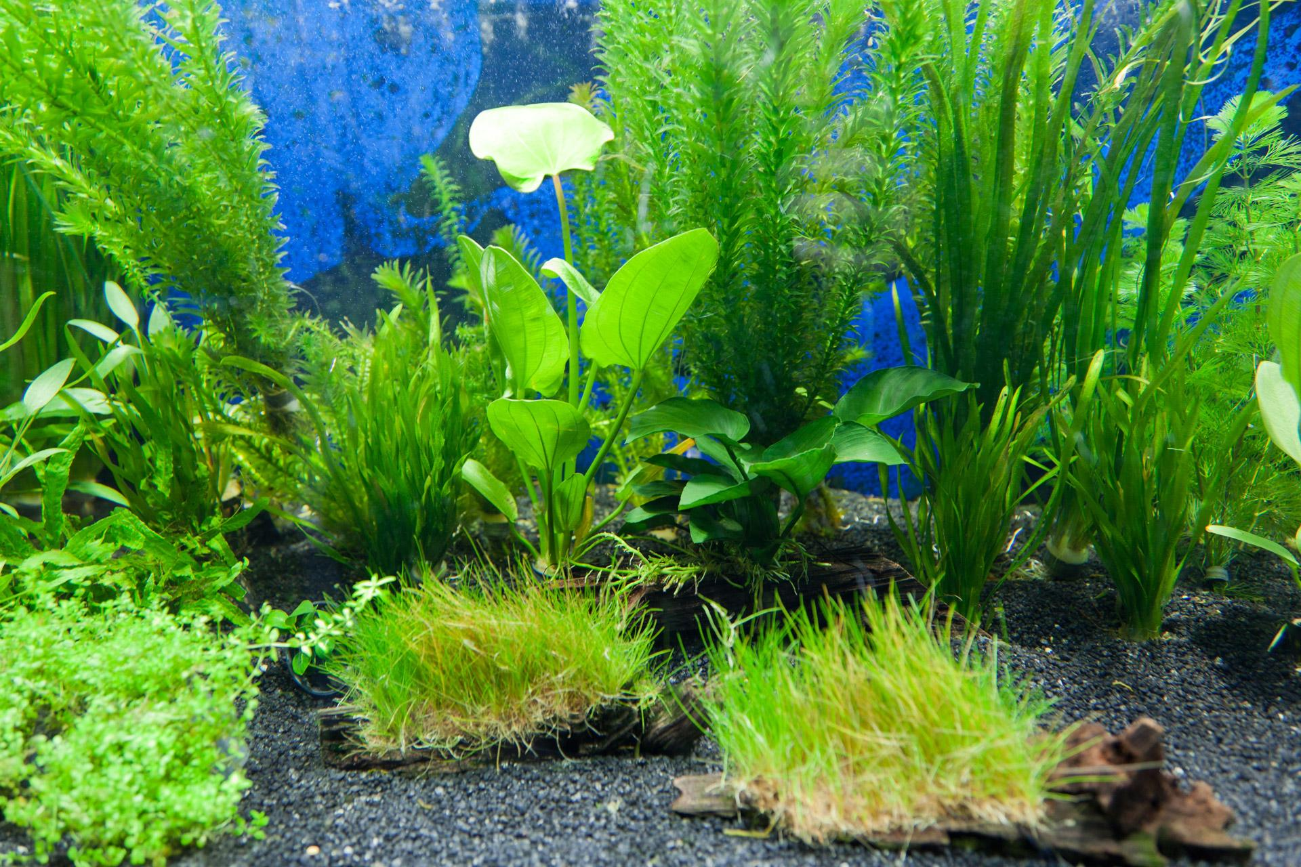
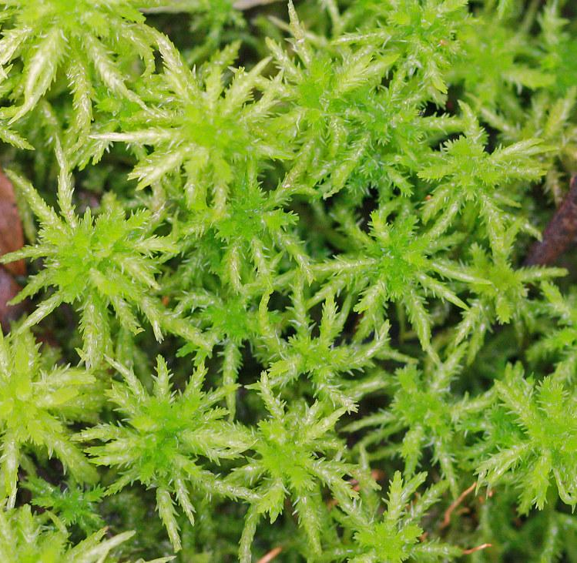
pH Buffer
Overtime the pH levels in the fish tank will decrease due to the production fish waste
In order to counteract this issues, we will be using seashells to rebalance the pH
When the Fish tank water reach a pH below 7
The seashells will begin to dissolve and releasing calcium carbonate, which return the pH around 7

Slide 13
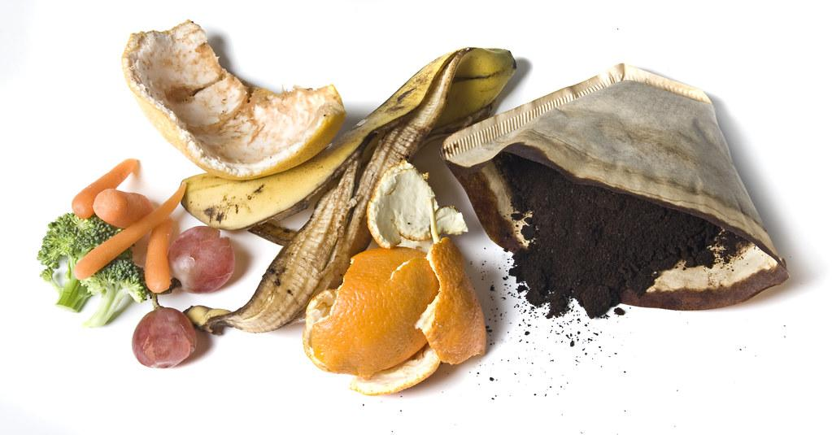
Compost
-Worm bin
Red wiggler 12.7 to 25°C 55 to 77°F
-Hot composting
54.4 to 60°C or 130 to 140°F
limit bacteria or weed seeds growing
Anaerobic Aerobic
Methane (CH4) vs Carbon Dioxide (CO2)

Slide 14
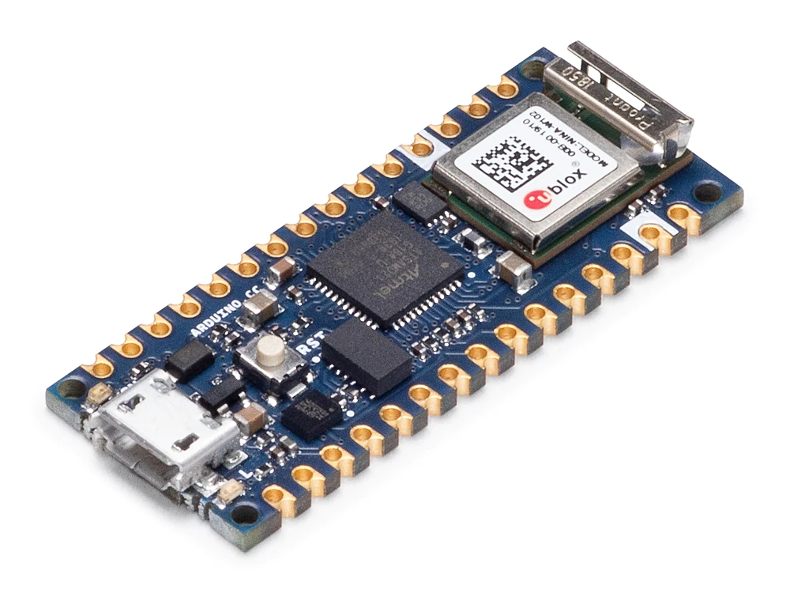
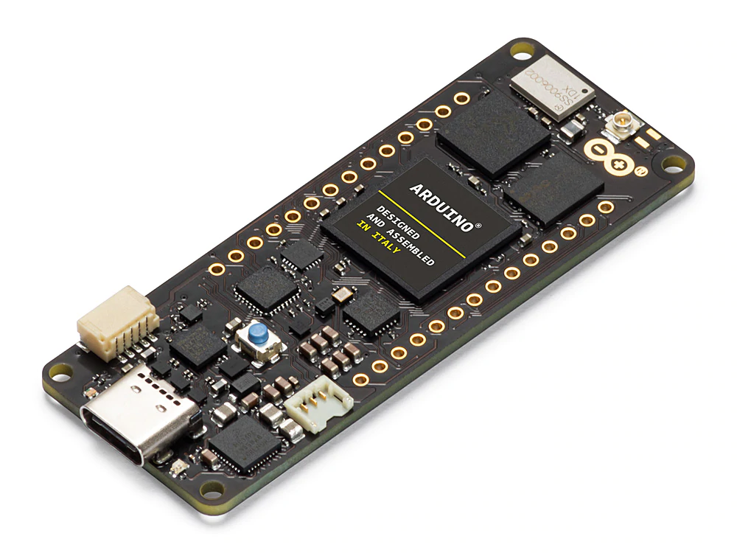
Parts - Arduino
Nano 33 IoT
Portenta H7
On-Board Chip | Flash Memory | Clock Speed | Connectivity | Pinouts
STM32H747 | 256 KB | 48 MHz | Wi-Fi (4,3,1) 802.11b/g/n | Analog: 8 inputs
 |  |  | Bluetooth 4.2 Bluetooth BLE | Digital: 14 Input/Output
 |  |  |  | PWM: 8 Output
On-Board Chip | Flash Memory | Clock Speed | Connectivity | Pinouts
STM32H747 | 16 MB | 480 MHz | Wi-Fi (4,3,1) 802.11b/g/n | Analog: 8 inputs
 |  |  | Bluetooth 4.2 Bluetooth BLE | Digital: 84 Input/Output
 |  |  | Ethernet | PWM: 10 Output

Slide 15
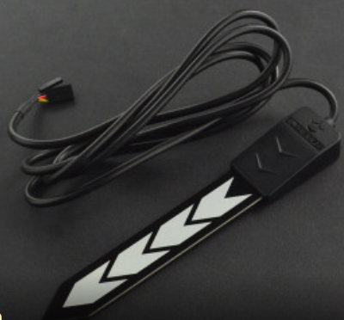
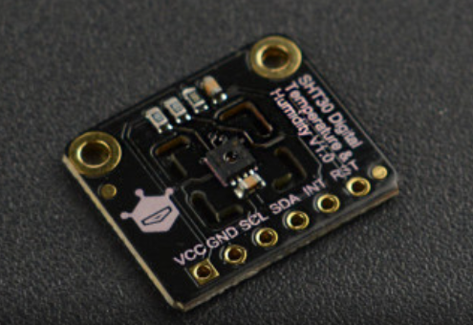
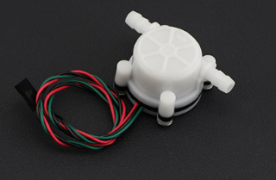
Parts - Sensors
Soil Moisture (Level) Sensor x3
SEN0308
Temperature and Humidity Sensor x4
SHT30
Flow Sensor x2
SEN0216
Water Temperature Sensor x1
DS18B20
All have an operating Voltage that is in between 3.3V-5V which makes for easy connection to the arduino.

Slide 16
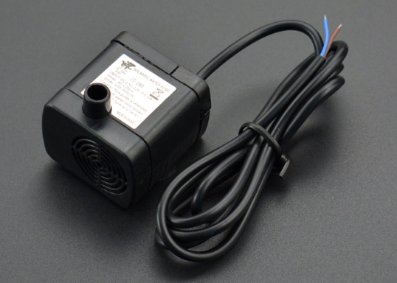
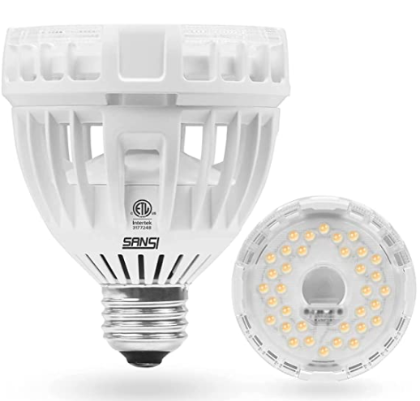
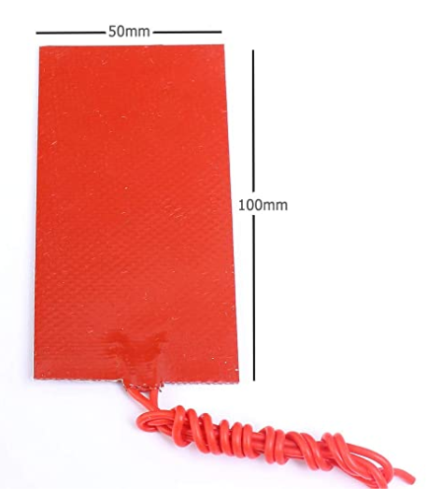
Parts - Hardware
Water Pump x6
FIT0200
Cooling Fans x4
Noctua NF-R8 redux-1800 PWM
Heating Cooling Elements x3
984-ATS-TEC40-39-004
Heating Pad x1
Icstation silicone rubber heating pad
Servo Motor x3
SunFounder 20KG Servo Motor SF3218MG
Grow Bulbs x4
SANSI Grow Light Bulb

Slide 17
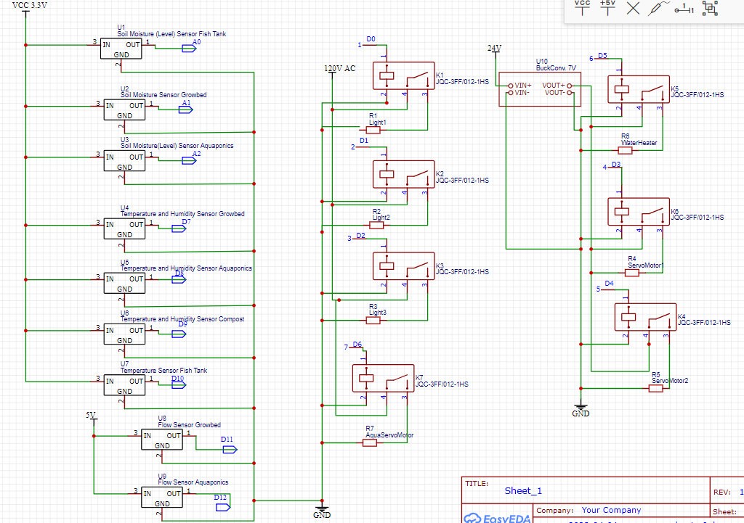
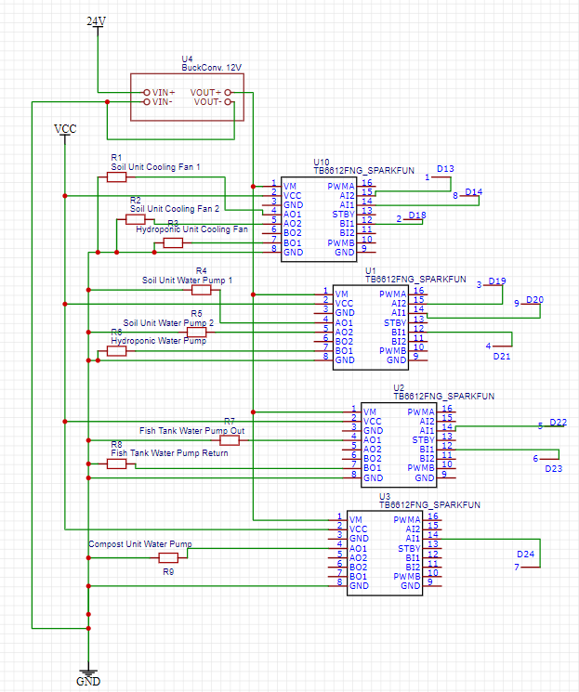
Electrical Diagram

Slide 18
Module Cost
Unit Name | Total Cost
Fish Tank Unit | $ 128.47
2 X Soil Unit | $ 258.10
Hydroponics Unit | $129.89
Composting Unit | $ 88.32
Communication Unit | $433.15

Slide 19
Total Power
Total Watts
Item | Quantity | Type | Current (A) | Voltage (V) | Watts Per Item | Total Watts
Water Heater | 1 | Actuator | AC | VAC | 50 | 50.00
Water Pump | 6 | Actuator | 0.416 | 12 | 5 | 30.00
Grow Bulbs | 4 | Actuator | 0.114 AC | 132 VAC | 15 | 60.00
Processing Unit | 1 | Actuator | 2 | 5 | 10 | 10.00
Heating Element | 3 | Actuator | 6 | 15.4 | 53 | 159.00
Servo Motor | 3 | Actuator | 2.1 | 7.2 | 15.12 | 45.36
Cooling Fans | 4 | Actuator | 0.2 | 12 | 2.4 | 9.60
Heat Pads | 1 | Actuator | 1.25 | 12 | 15 | 15.00
Water Temperature Sensor | 1 | Sensor | 0.0015 | 5 | 0.0075 | 0.01
Flow Sensor | 2 | Sensor | 0.015 | 5 | 0.075 | 0.15
Digital Temperature and Humidity Sensor | 4 | Sensor | 0.0025 | 5 | 0.00323 | 0.01
Soil Moisture Sensor | 3 | Sensor | 0.0015 | 5 | 0.00495 | 0.01
Total + 20% |  |  |  |  |  | 454.97

Slide 20
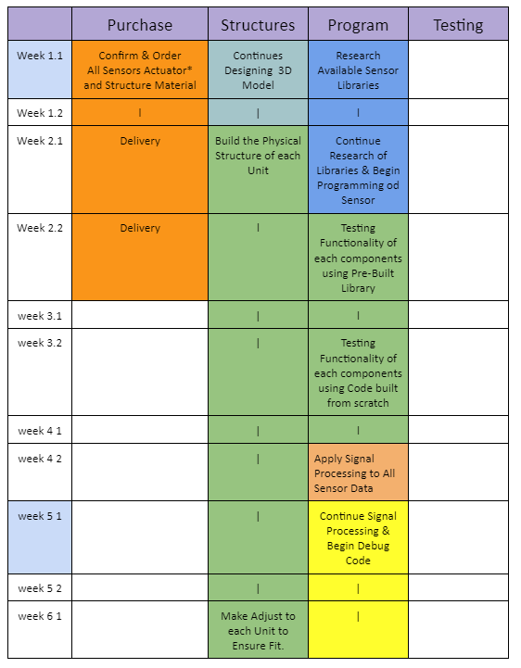
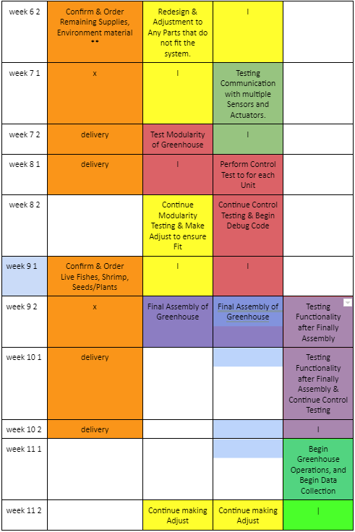
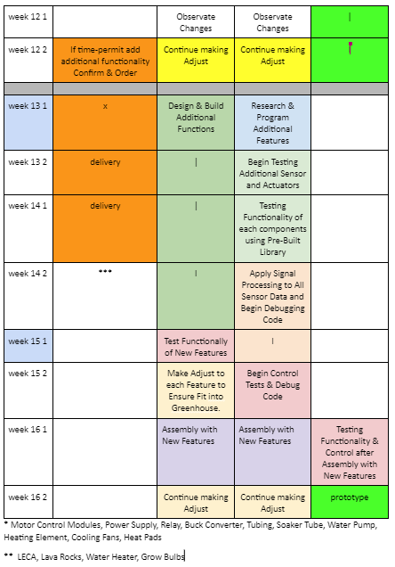
Project Schedule

Slide 21

Question

